Slide 1

Project Forecasting
Oil Price Prediction
Presented by:
Sai deepthi Anupoju - saideepthianupoju@gmail.com

Slide 2
Contents:
Introduction
EDA & Visualization
Feature Engineering
Model Building & Evaluation
Deployment
Conclusion

Slide 3
Introduction
Crude oil price prediction is a challenging task in oil producing countries.
Its price is among the most complex and tough to model because fluctuations of price of crude oil are highly irregular, nonlinear and varies dynamically with high uncertainty.
Oil is the major source of heating and energy in the world, which makes it challenge to replace it with other resources.
Oil heavily affect the economic growth, from common consumer products to military and energy sectors.
Unexpected movements on oil price has effects on economic stability for both supplier and producer countries, although more crucial for oil importing countries.
Several studies concluded that it is harmful when the oil price has more volatility and is less predictable, which can have negative effect on many economic indicators.
Oil demand and supply are quite inelastic in short term, that makes the price skyrocketed when the demand for oil exceeds supply.
This Project focuses on time series based models and compares their accuracy. It also implements some of these models to predict price of (WTI).

Slide 4
Business objective:
Oil is a product that goes completely in a different direction for a single market event as the oil prices are rarely based on real-time data, instead, it is driven by externalities making our attempt to forecast it even more Challenging. As the economy will be highly affected by oil prices our model will help to understand the pattern in prices to help the customers and businesses to make smart decisions.
The problem statement for oil price prediction involves developing a model that can accurately forecast future oil prices based on historical data and relevant influencing factors. The primary challenge is to create a predictive model that provides reliable and timely information to help businesses, investors, and policymakers make informed decisions in the volatile and complex oil market.
The main goal is to predict future oil prices accurately within a reasonable time frame.
The prediction model should be designed to assist stakeholders in making strategic decisions related to resource allocation, risk management, and investment planning.

Slide 5
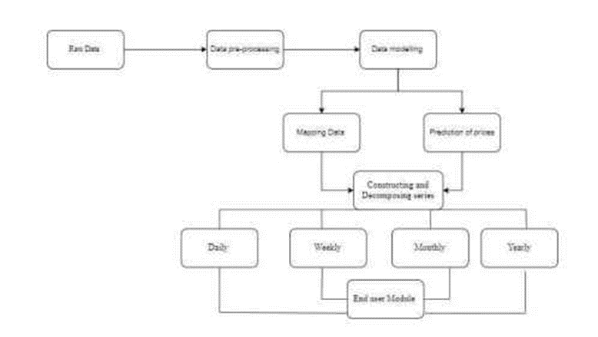
Project Architecture
Data Collection
Data Preprocessing
Feature Engineering
Model Selection.
Model Evaluation
Deployment of final model

Slide 6
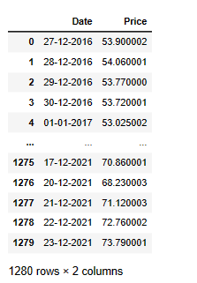
Data summary
Dataset Link: https://www.eia.gov/dnav/pet/hist/RWTCD.htm
Description: This is a publicly available data-set provided by EIA (Energy Information Administration) consisting of price of Cushing OK WTI Spot Price FOB(Dollars per Barrel) - From JAN 1986 till OCT 2023 excluding weekends and holidays.
Domain Knowledge:
West Texas Intermediate (WTI - Cushing): A crude stream produced in Texas and southern Oklahoma which serves as a reference or "marker" for pricing a number of other crude streams and which is traded in the domestic spot market at Cushing, Oklahoma.

Slide 7
Exploratory data analysis:
EDA & Visualization
The data was explored using Matplotlib for visualizations of the time series data and find patterns/insights from the data and Pandas was used to compute data with aggregation to derive insights on any seasonal trends.
There are no null values in the data are missing in the data.
Data is right skewed as the mean is greater than mode, clearly there are some high values that pull the mean to right. Max closing price-$145.31
As the range is large: max-min- $135, we can say that over the years, there has been a lot of variation in the price it oil.
There may be outliers towards the right side of distribution because the Interquartile range (IQR-Q3-Q1) is around 50 but max closing price is 145

Slide 8
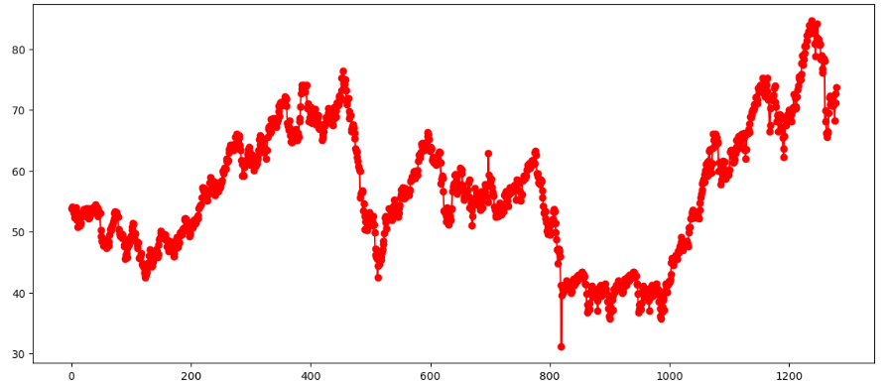
Visualization of crude oil data as time series analysis:
Inferences from Line plot:
We can clearly see that price has decreased over the period (1986 -2000). However an upward trend can be noticed from 2001 to 2023 reflecting rise in world economy and ever-increasing demand and dependency on crude oil.
In 2020, the crude oil price hit a record low.

Slide 9
Visualization Insights
From 2007 to 2008 there has been a surge in price reaching it’s peak in 2008.
From 2008 to 2009, the prices crashed because of global financial crisis.
From 2009 to 2019 we can see that price increased and decreased gradually as the economy recovered.
From 2020 to 2021 we can see oil price crash due to COVID-19 Lockdowns.
we can note that price kept on increasing as the economies started to recover until June 2022, after which supply & demand disruptions caused due to Russia-ukraine war.
Overall we can say that the price fluctuates a lot over time as it is easily influenced by various factors such as supply and demand, geopolitics, economic growth, pandemic outbreak, war crisis etc. So I can say that it's very difficult to predict future crude oil price as it's very volatile due to factors mentioned before which are itself unpredictable and co-related.

Slide 10
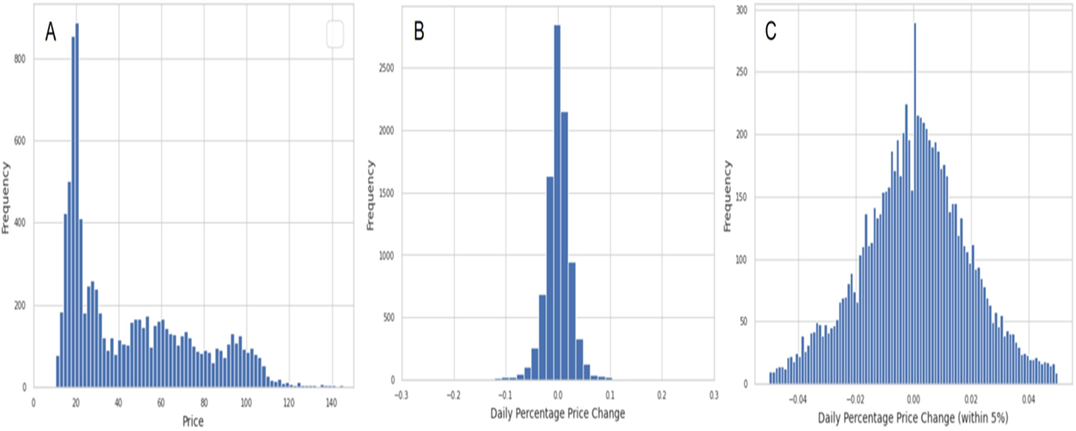
Histogram Plot:
The daily percent changes in crude oil price is mostly small, showing stability or time, we can say that the distribution range is mostly within 100% on daily level.
We can see that the tail is towards left which means that daily percentage changes have higher probability of being negative than positive. As observed in the line plot above, we can see that price have crashed suddenly more than once, but never has it Increased in the same order.

Slide 11
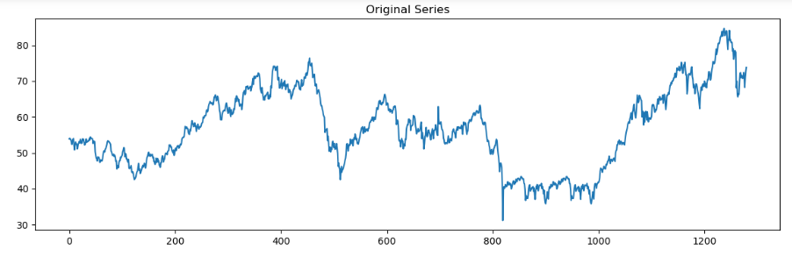
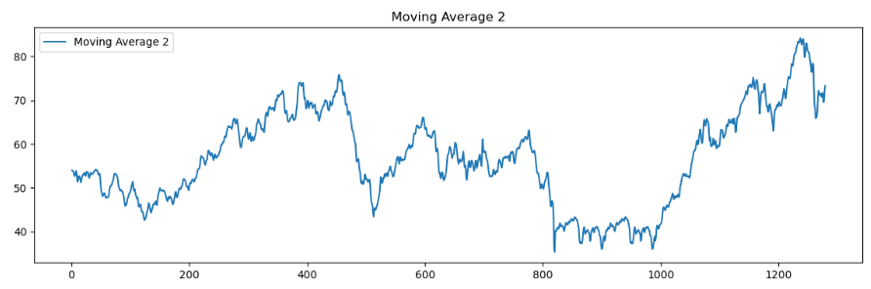
Time Series Decomposition plot

Slide 12
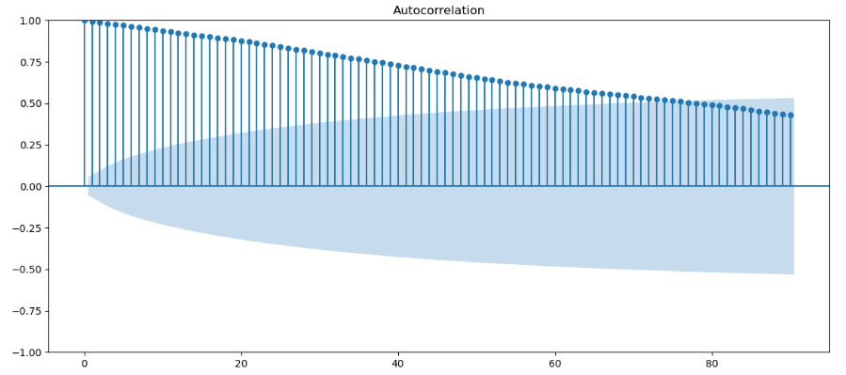
ACF Plots and PACF Plots

Slide 13
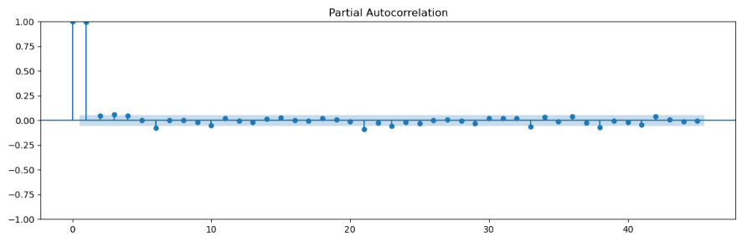
Partial Auto Correlation Function(PACF)

Slide 14
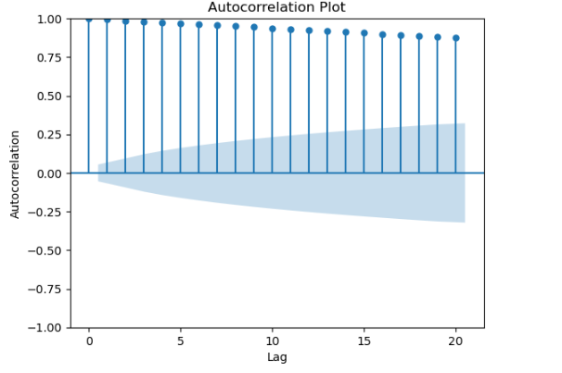
Time Series Composition 1. Seasonality 2. Trend Autoregression Model

Slide 15
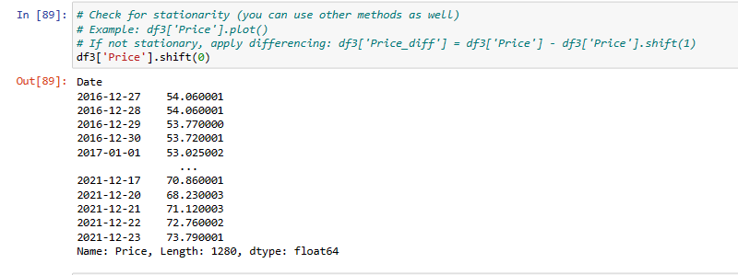
ARIMA MODEL

Slide 16
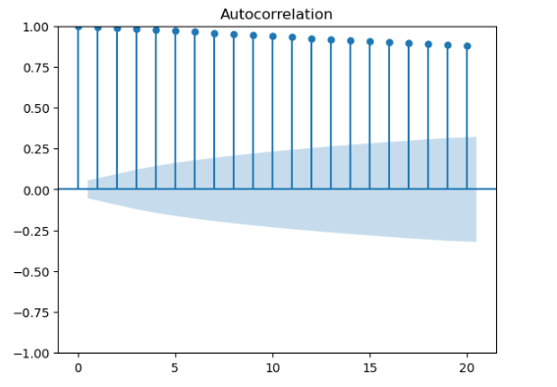
Auto Correlation Plots

Slide 17
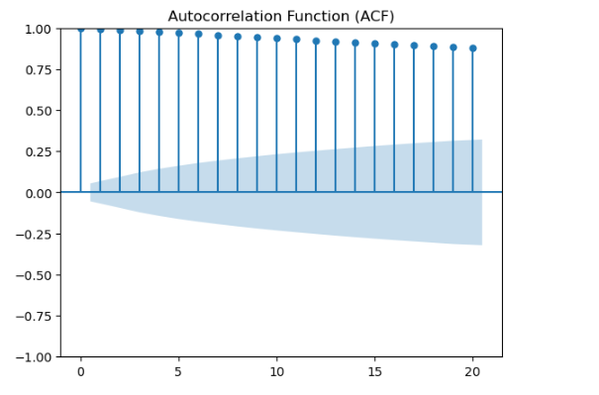
Auto Correlation Function ( ACF)

Slide 18
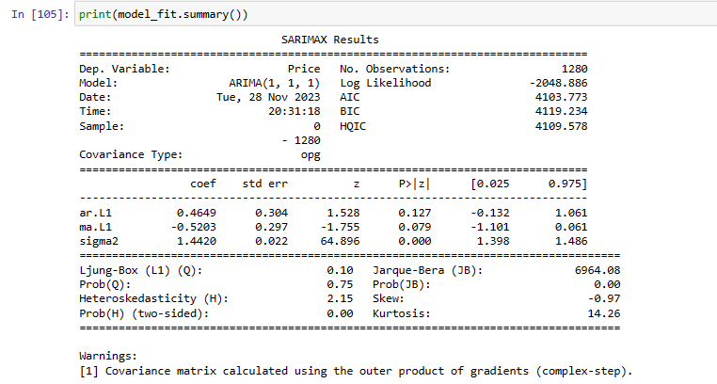
Fit the ARIMA Model

Slide 19
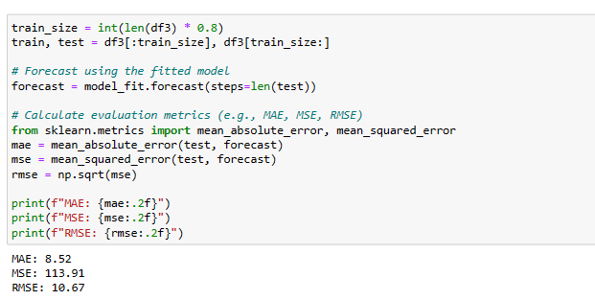
Model Evaluation:
Mean Absolute Error (MAE): 8.52
Mean Squared Error (MSE): 113.91
Root Mean Squared Error (RMSE): 10.67
These values indicate how well your ARIMA model performs in predicting the oil prices. Lower values of MAE, MSE, and RMSE suggest better model accuracy. Remember to monitor the model’s performance over time and make any necessary adjustments as needed.

Slide 20
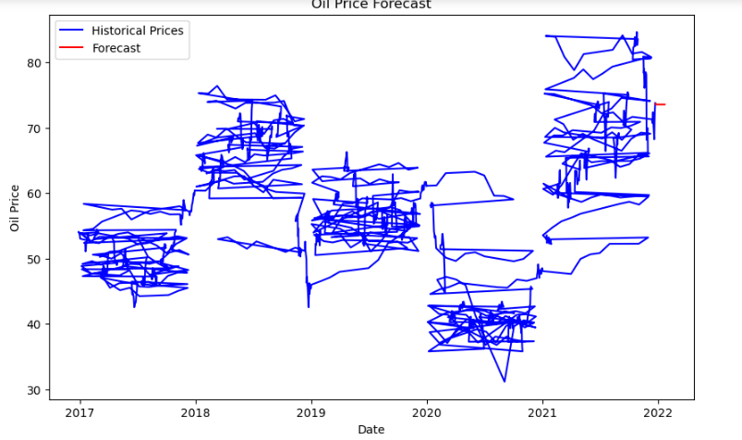
Oil Price Forecast:

Slide 21
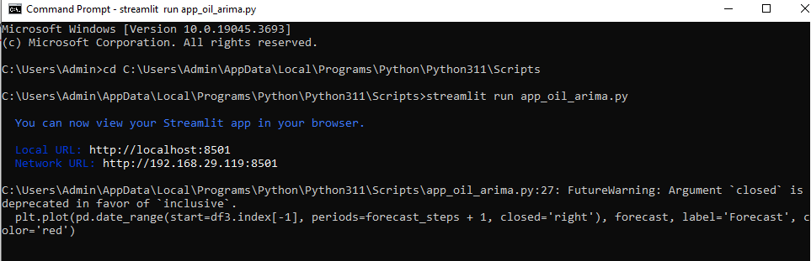
Deployment codes in Command Prompt in Streamlit

Slide 22
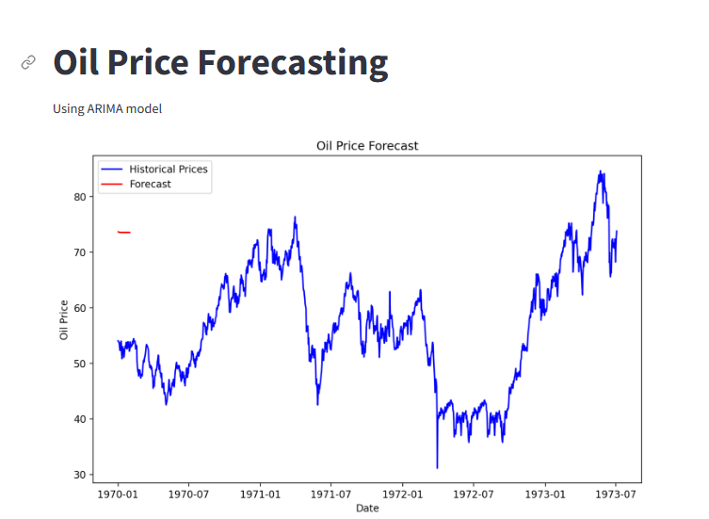
Output of Forecast

Slide 23
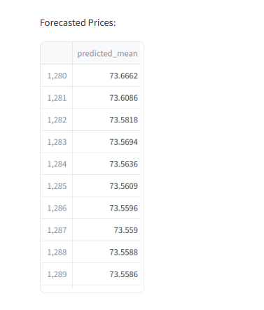
Model Deployment – Platform Streamlit

Slide 24
Project - Challenges
Exploratory Data Analysis (EDA):
EDA involves understanding the data, identifying patterns, and visualizing trends. For oil price prediction, explore historical price data, seasonality, and any significant events (such as geopolitical shifts or economic cycles) that might impact prices.
Consider using statistical tools and visualization libraries (like Python’s Pandas, Matplotlib, or Seaborn) to gain insights from the data.
ARIMA Model Building:
ARIMA (AutoRegressive Integrated Moving Average) is a powerful time-series forecasting technique.
Steps for ARIMA model building:
Stationarity: Ensure the time series data is stationary (constant mean and variance). If not, apply differencing to make it stationary.
ACF and PACF: Analyze the AutoCorrelation Function (ACF) and Partial AutoCorrelation Function (PACF) plots to determine the order of ARIMA components (p, d, q).
Model Selection: Choose appropriate values for p, d, and q based on ACF and PACF plots.
Model Fitting: Fit the ARIMA model to the data.
Model Evaluation: Evaluate the model using metrics like Mean Absolute Error (MAE), Mean Squared Error (MSE), or Root Mean Squared Error (RMSE).

Slide 25
Project - Challenges
3.Deployment Challenges:
Deploying a predictive model involves several considerations:
Scalability: Ensure the model can handle real-time data and scale efficiently.
Data Updates: Regularly update the dataset to keep the model relevant.
Monitoring: Monitor model performance and retrain periodically.
Interpretability: Explain the model’s predictions to stakeholders.
Infrastructure: Choose an appropriate deployment environment (e.g., cloud services, on-premises servers, or edge devices).
Security: Protect sensitive data and ensure secure access to the deployed model.
4.Presentation:
Create a compelling PowerPoint presentation (PPT) to convey your findings and insights.
Structure your PPT with clear sections:
Introduction
Data Overview (including EDA insights)
Model Building (ARIMA details)
Deployment Challenges
Conclusion and Recommendations

